Slide 1
A Seminar on HYPERSPECTRAL IMAGE PROCESSING USING DEEP LEARNING TECHNIQUES
Team Details
R. Divija(20EG105439)
V.Mahesh(20EG10544E.Vishnu(20EG105720)
Project Supervisor
Dr. P. Ratna Sekhar
Designation: Asst Professor Dept of CSE

Slide 2
Introduction
A Hyperspectral Image (HSI) is a digital image that encompasses a broad range of electromagnetic wavelengths, extending beyond the limited three bands (Red, Green, Blue) found in regular RGB images. HSIs consist of hundreds or even thousands of narrow and adjacent bands, covering an extensive spectrum.
A Hyperspectral Image (HSI) is formed by dividing the electromagnetic spectrum into narrow bands, creating numerous spectral channels. Each channel represents a specific wavelength range. In an HSI, every pixel has a unique spectral signature with intensity values reflecting the object's reflectance or radiance at different wavelengths. This spectral data facilitates identifying and analyzing materials and object characteristics in the captured image
Material Identification, Agriculture and Precision Farming, Defense and Surveillance, Medical Imaging are the applications.

Slide 3
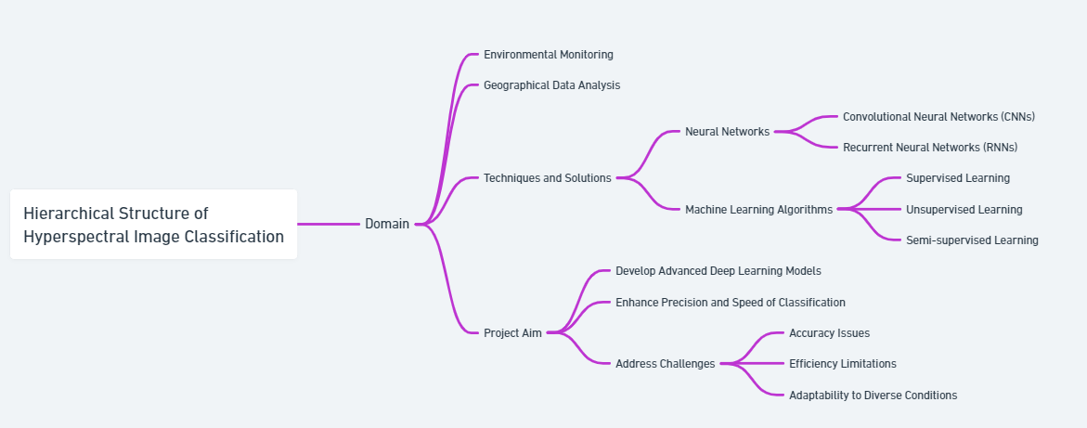
Concept Tree

Slide 4
Literature
Sl.No | Author | Strategies | Advantages | Disadvantages
1. | Feng, Xumin Yu | Use of convolutional neural networks (CNNs) and band expansion techniques in hyperspectral image change detection | Enhances discrimination of change classes; potentially improved performance in change detection compared to traditional methods | Contextual Ambiguity and spectral mixing
2. | Yushi Chen, Hanlu Jiang | convolutional neural networks (CNNs) for deep feature extraction in hyperspectral image classification. Employing regularization techniques like L2 regularization and dropout to avoid overfitting. | Improved classification accuracy due to deep feature extraction | The complexity of CNN architectures can lead to increased computational requirements.
3. | Indira Bidari, Satyadhyan Chickerur | Integration of methods like PCA for dimensionality reduction and SVM for classification; Use of deep learning for automatic feature extraction. | Effective handling of high dimensionality in hyperspectral data | Increased computational complexity and redundancy
4. | Yanlong Gao | Developing a hierarchical CNN for feature extraction and classification, employing raw images as input, avoiding image block processing, using SVM for classification | More efficient processing by avoiding image block analysis, better feature extraction through hierarchical CNN layers, combining CNN with SVM for improved classification | potential challenges in optimizing CNN for specific hyperspectral scenarios, managing high dimensionality

Slide 5
Literature(cont..) selected strategy:
Sl.No | Strategies | Advantages | Disadvantages
1 | Convolutional Neural Networks (CNNs) | - Efficient in spatial and spectral feature capture - Effective for image data with hierarchical feature learning | - Requires large labeled data - Computationally intensive - Risk of overfitting on small datasets
2 | Recurrent Neural Networks (RNNs) and genetic encoding | - Good for sequential data and spectral dependencies - Handles variable-length input sequences | - Less effective in spatial feature extraction - Training challenges due to gradient issues
3 | Autoencoders and termination criteria | - Excellent in dimensionality reduction - Learns compressed data representations | - Network architecture needs careful tuning - Potential loss of critical information
4 | Hierarchical Feature Extraction with CNN | - Leverages pre-trained models to reduce data need - Speeds up training and potentially improves performance | - Requires careful source model selection and tuning - Limited effectiveness if domains are very different

Slide 6
Problem Statement
Current methods for hyperspectral image classification face challenges in accuracy, efficiency, and adaptability to diverse environmental conditions. This project aims to address these limitations by developing advanced deep learning models processing both spectral and spatial data, the project seeks to enhance feature extraction capabilities, thereby improving accuracy in material identification, object detection, and land cover classification within hyperspectral images.The goal is to enhance the precision and speed of classification, enabling more accurate monitoring and analysis of environmental and geographical data.

Slide 7
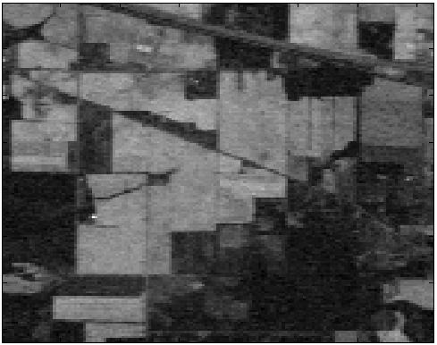
Problem Illustration
Before image processing
Here the image is taken by satellite of Indian pines ,by observing every crop looks alike and finds no difference.

Slide 8
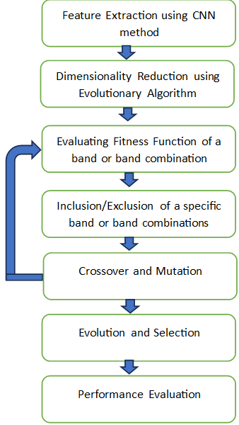
Proposed Method
Our proposed method involves combining Convolutional Neural Networks (CNNs) and Evolutionary Algorithms (EAs) to address the challenges of hyperspectral data.
First, CNNs are employed to extract hierarchical features from hyperspectral images. To tackle the computational difficulties arising from the abundance of spectral bands, EAs, including Genetic Algorithms and Differential Evolution, are used to identify an optimal subset crucial for effective classification.
The Evolutionary Algorithm iteratively refines band subsets through genetic operators such as crossover and mutation, prioritizing those yielding higher fitness, indicative of better classification. The process continues until a termination condition is met.
The final subset is then independently validated, evaluating the performance of the CNN classifier using the reduced feature space.

Slide 9
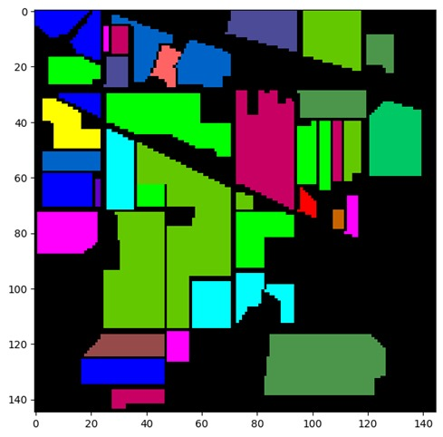
Proposed Method Illustration
After the image processing done the raw image is converted to Hyperspectral image and helps to process image easily.
Before image processing After image processing

Slide 10

Parameter
Dimensionality Reduction:
The chosen subset reduces the number of spectral bands, simplifying subsequent processing.
Principal component analysis:
Suppose we have a hyperspectral dataset with n observations and m spectral bands. Each observation is represented by a vector xi​ of length m, where i ranges from 1 to n. The dataset can be arranged into a matrix X of size n×m.
Calculate Eigenvectors and Eigenvalues
Solve for the eigenvectors v and eigenvalues λ of the covariance matrix:
Σ=Σv=λv
Sort Eigenvectors by Eigenvalues
Arrange the eigenvectors in descending order based on their corresponding eigenvalues.
Select Principal Components
Choose the top k eigenvectors to form a transformation matrix W:
=[1,2,…,]W=[v1​,v2​,…,vk​]
The transformed data new Xnew​ is obtained by multiplying the original data matrix X by W:
new=Xnew​=X⋅W

Slide 11
Experiment Environment
DATASETS: Kaggle, GitHub
IDE: Google Colab
Language: Python
Dataset:https://www.kaggle.com/datasets/abhijeetgo/indian-pines-hyperspectral-dataset

Slide 12
Project status
S.No | Functionality | Status (Completed /in-progress/Not started)
1. | Data set collection | completed
2. | Training and Testing | In progress
3. | Spectral and spatial Functionality | In progress
4. | Continuos evaluation and mutation | Not started

Slide 13
References
[1] K. Makantasis, K. Karantzalos, A. Doulamis and N. Doulamis, "Deep supervised learning for hyperspectral data classification through convolutional neural networks," 2015 IEEE International Geoscience and Remote Sensing Symposium (IGARSS), Milan, Italy, 2015, pp. 4959-4962, doi: 10.1109/IGARSS.2015.7326945.
[2] X. Jia, B.-C. Kuo, and M. Crawford, “Feature mining for hyperspectral image classification,” Proc. IEEE, vol. 101, no. 3, pp. 676–697, Mar. 2013.
[3] B. Pan, Z. Shi, Z. An, and Z. Jiang, “A novel spectral-unmixingbased green algae area estimation method for GOCI data,” IEEE J. Sel. Top. Appl. Earth Obs. Remote Sens., vol. 10, no. 2, pp. 437–449, Feb. 2017.
[4] Grewal, R., Kasana, S.S. & Kasana, G. Hyperspectral image segmentation: a comprehensive survey. Multimed Tools Appl 82, 20819–20872 (2023). https://doi.org/10.1007/s11042-022-13959-w.
[5] P. Liu, H. Zhang and K. B. Eom, "Active Deep Learning for Classification of Hyperspectral Images," in IEEE Journal of Selected Topics in Applied Earth Observations and Remote Sensing, vol. 10, no. 2, pp. 712-724, Feb. 2017, doi: 10.1109/JSTARS.2016.2598859

Slide 14
Thank you

Slide 15
Project seminar–I Evaluation
S.No | Rubrics | Marks
1 | Concept Introduction | 4
2 | Literature and Parameter | 5
3 | Problem and Problem Illustration | 8
4 | Proposed Method and Illustration | 8
Total |  | 25

